Slide 1
Front End Engineering-I Project
Team Details: Keshav Gupta(2410993043)
Kushan Garg(2410993053)
Yashit Mittal(2410993075)
Faculty Coordinator: Pavan Ambulkar
:
Chitkara University Institute of Engineering and Technology,
Chitkara University, Punjab

Slide 2
Table of Contents
Introduction
Problem Statement
Goals
Technical Stacks
Key Features
Project Highlights
Conclusion
References/Links used

Slide 3
Introduction
IMAGE GALLERY
TEAM MEMBERS : KESHAV GUPTA(2410993043)
KUSHAN GARG(2410993053)
YASHIT MITTAL(2410993075)
In today's digital world, images are often more impactful than words, and there is a need for a well-organized and visually appealing site to share images. Our Image Gallery Website Project is addressing this problem head on with a full-featured, responsive, user-friendly experience for uploading, organizing, and sharing images.
This project is built for many different types of users: photographers, designers, businesses or casual users creating a personalize or professional online gallery. Additionally, this site allows the users to showcase their visual content and to engage with their images in a unique web experience using the latest web technology.

Slide 4
Problem Statement
Today's world is image-centric. Everyone needs a simple, accessible, and secure solution to manage and display images online, including individuals and businesses as well as creative professionals. Current image management tools miss the mark in several key areas, including simplicity, customization, searchability, and scope.
The Image Gallery Website Project aims to solve these issues by providing an affordable, feature-rich platform that emphasizes ease of use, advanced organization capabilities, robust security, and a mobile-responsive design. Our goal is to create a scalable solution that empowers users to efficiently manage and share their images while maintaining full control over privacy and presentation.
The present undertaking can be described as a balance between design, functionality and user experience. We aim at providing a solution that goes beyond the mere practical aspect of the users and allows them to showcase their visual narratives in a more professional and exciting way.

Slide 5
Goals
To develop a visually attractive, user-friendly platform to manage and display images on the Internet.
To provide advanced features such as image grouping (or categories), search, and tagging for an efficient organization.
To create a responsive and mobile-friendly interface that works well across a wide range of devices.
To establish high standards of security and privacy for user-uploaded content.
To develop a reliable, high-performance website that can accommodate large numbers of images and users..

Slide 6
TECHNICAL STACKS
HTML-STRUCTURE OF PAGE:
HTML forms the foundation of the website, providing the structural layout for all content.
ROLE: Organizes images into grids and galleries. And Defines the basic elements like text, buttons, and links.
BENEFITS : Ensures accessible and well-organized content along with optimization for SEO and cross-browser compatibility
CSS– DESIGNING :
CSS is responsible for styling and designing the visual aspects of the website.
ROLE: Controls the appearance of the image galleries, text, and layout along with Implements responsive design, ensuring the website looks great on all devices.
BENEFITS: Creates a visually appealing and consistent design.
RESPONSIVE AND INTERACTIVE UI WITH CSS:
CSS ensures that the website adapts seamlessly to different screen sizes.
ROLE : Media queries are used to make the website fully responsive for mobile, tablet, and desktop devices. And Hover effects and other interactive styles enhance the user experience.
BENEFIT : Smooth, engaging interactions. And Optimized layouts for every device.

Slide 7
KEY FEATURES
User-Friendly Interface: Designed for simplicity, the intuitive dashboard allows users of all levels to easily manage images, create galleries, and personalize content with ease.
Advanced Search and Filtering: Users can quickly sort and organize large image collections using filters like categories, tags, dates, and metadata for efficient searching.
Responsive Design: Optimized for all screen sizes, the platform ensures a consistent visual experience across mobile, tablet, and desktop devices.
High-Quality Image Display: Images are optimized for fast loading while maintaining high quality, ensuring a smooth and visually appealing browsing experience.

Slide 8
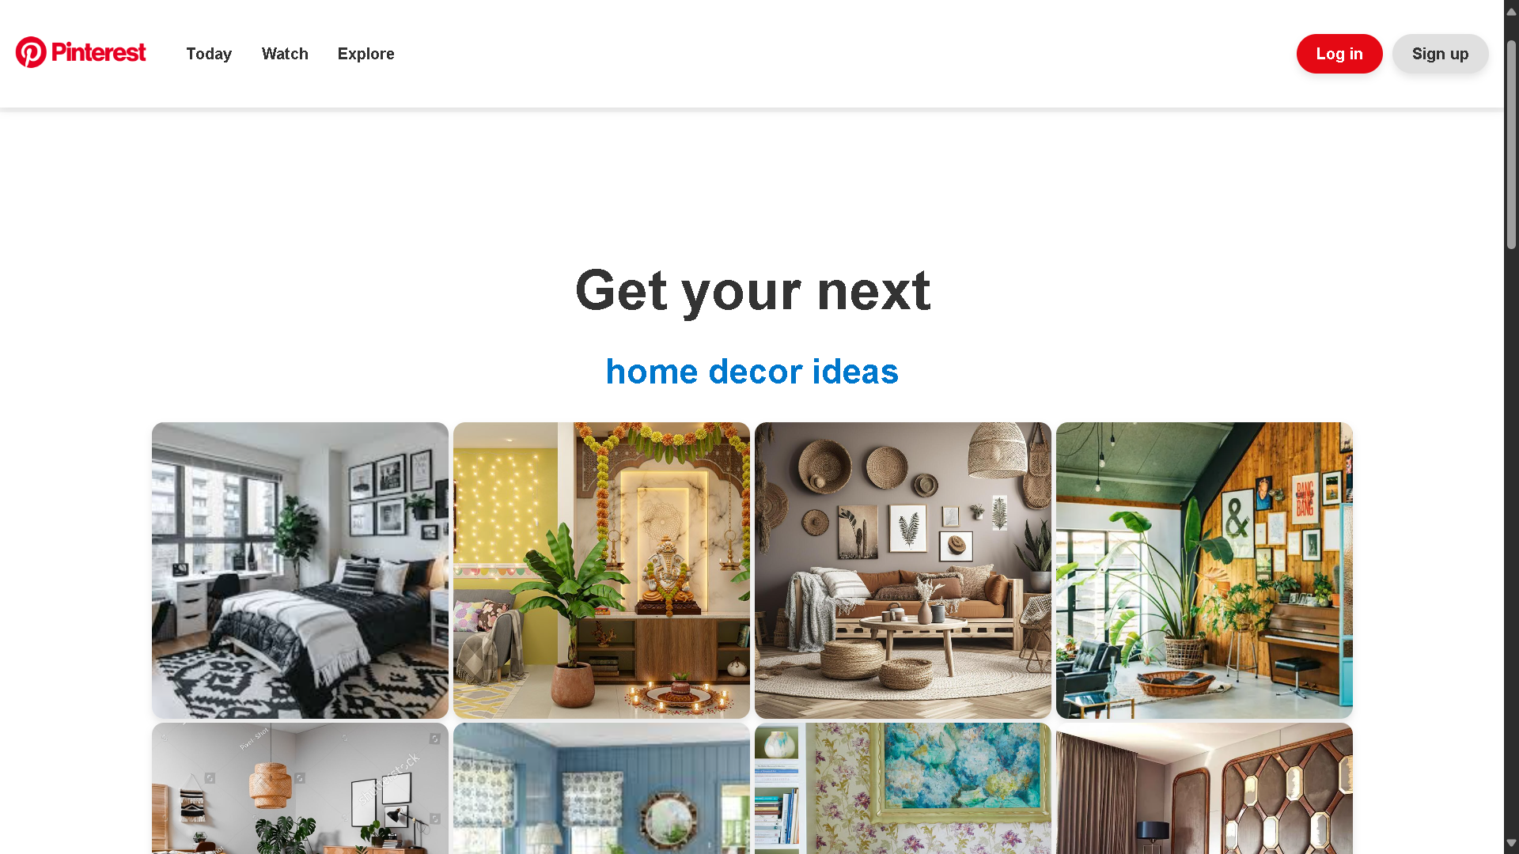
Project Highlights
HOME PAGE

Slide 9
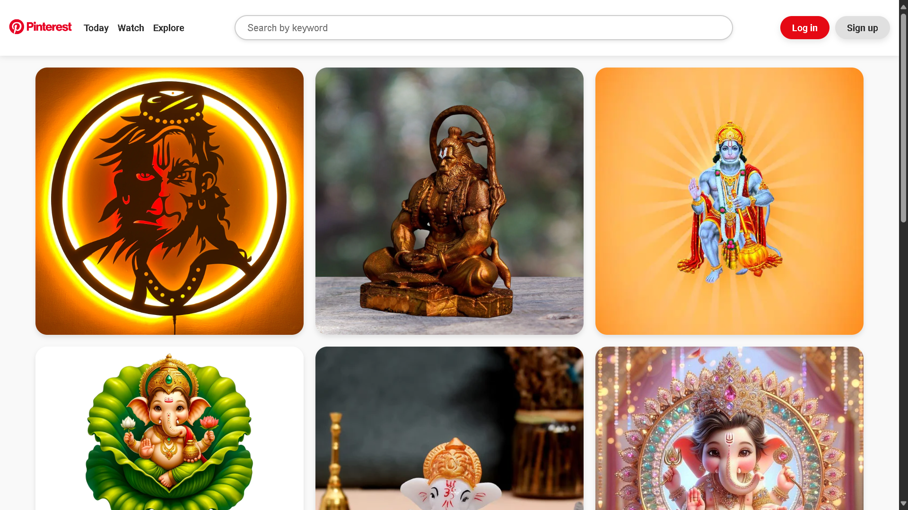
Project Highlights

Slide 10
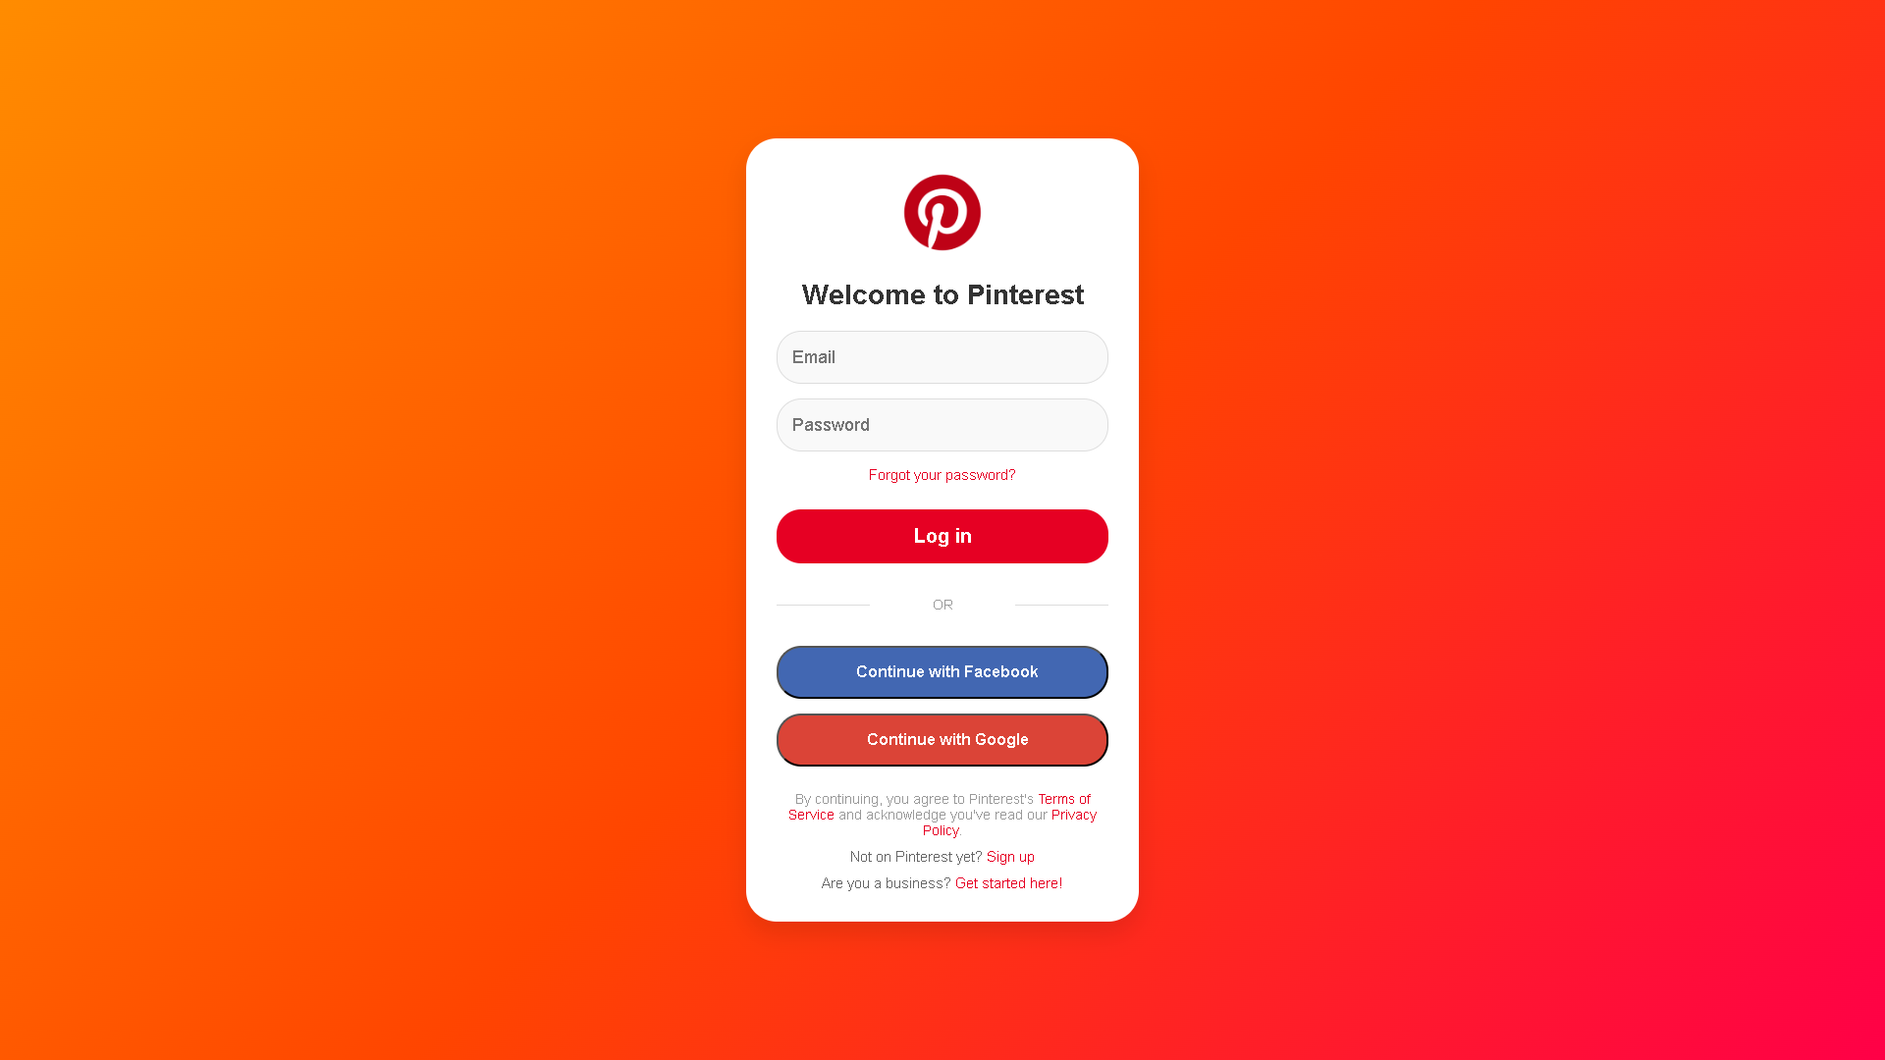
Project Highlights
LOGIN PAGE

Slide 11
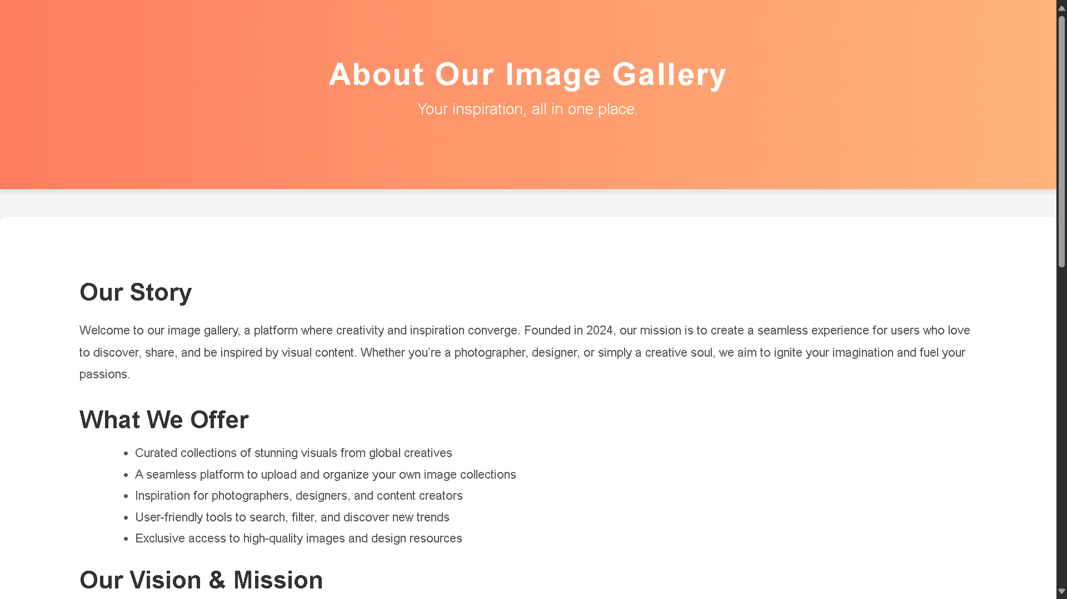
Project Highlights
about PAGE

Slide 12
Conclusion
The Image Gallery Website Project aims to offer a complete and easy-to-use system for managing, promoting and distributing images. This project focuses on effective navigation, design maturity and improved function and answering a growing demand from photographers, artists, companies and even occasional users.
This project embodies a well-thought-out combination of design, function, and technology to provide an engaging solution for the users who require an easy-to-use but a powerful platform for organizing their images. Along the lines, the Image Gallery Website has sustainable development and growth with the addition of new features and enhancements overtime, increasing its value and the user experience respectively.

Slide 13
References
Throughout the development of the Image Gallery Website Project, various resources were consulted to ensure the implementation of best practices in web development. The following references provided valuable insights and guidance:
1. Google Search
Used extensively to gather information, troubleshoot issues, and explore examples of similar projects and best practices for HTML and CSS implementation.
2. Official Documentation
HTML and CSS Documentation: Resources from MDN Web Docs and W3Schools were consulted for best practices, coding standards, and technical explanations.
3. AI Models Insights were derived from AI-based tools to assist in code generation, image optimization suggestions, and design enhancements.
4. YouTube Videos Tutorials from various YouTube channels provided in-depth explanations and examples of responsive design, CSS animations, and interactive elements.
5. Pinterest Official Website Design inspiration for layout and image grid styles was drawn from the Pinterest platform, helping guide visual elements and UI/UX principles for the gallery structure.

Slide 14


